Slide 1
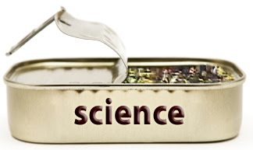
What is Open Science and How do I do it?
Lorne Campbell
University of Western Ontario

Slide 2


Open Science Resources
A lot has been developed in a short period of time
Society for the Improvement of Psychological Science (SIPS)
Improving Science in Individual Labs

Slide 3

Why Should Science Be Open?
Evaluation requires understanding the methods used, and in what context
Reproducibility
Replicability

Slide 4
Canadian Government Commitment to Open Science
Commitment 14: Increase Openness of Federal Science Activities (Open Science)
The Government of Canada will take appropriate steps to make the science performed in support of Government of Canada programs and decision-making open and transparent to Canadians.
…the Government of Canada wants to build on past work by taking bold steps to make government-funded* science open and transparent to Canadians
* such as by the tri-councils, or the agencies that fund most research in Canada

Slide 5
The Transparency and Openness Promotion Guidelines (TOP)
Eight modular standards, each with three levels of increasing stringency for openness
Signatories
751 journals
63 organizations
Many psychology journals are signatories
E.g., JESP, JSPR, PR, Perspectives, Social Psychology, PLoS One, Frontiers, Collabra

Slide 6
The Research Process
Ask a Question
Review Literature
Formulate Hypothesis
Design/Run Study
Make Inferences
Report Results

Slide 7
The Research Process:
Status Quo
Public
Ask a Question
Review Literature
Formulate Hypothesis
Design/Run Study
Make Inferences
Report (positive) Results
Private

Slide 8
The Research Process:
Open Science
Public
Ask a Question
Review Literature
Formulate Hypothesis
Design/Run Study
Make Inferences
Report (all)
Results
Documenting the Research Workflow

Slide 9
Doing Open Science
We receive a lot of training on research methods and statistical procedures (but likely not enough—another talk!)
But, not much (if any) on how to do open science
Technology today allows for open science practices

Slide 10

What to do?

Slide 11

Challenges, not Roadblocks
“Well I tell them there’s no problem, only solutions”

Slide 12
Key Terms
Registration
Pre-registration

Slide 13
Key Terms for Using the Open Science Framework (OSF)
Types of Pages
Project
dynamic
Registration
fixed
Can be:
Private or Public
And can contain:
components

Slide 14
Key Terms for Using the Open Science Framework (OSF)
Version Control
Wiki, commenting
Licensing and DOIs
Compatibility with other websites and/or apps
E.g., Dropbox, Google Drive, Github, Figshare, Dataverse, Box

Slide 15
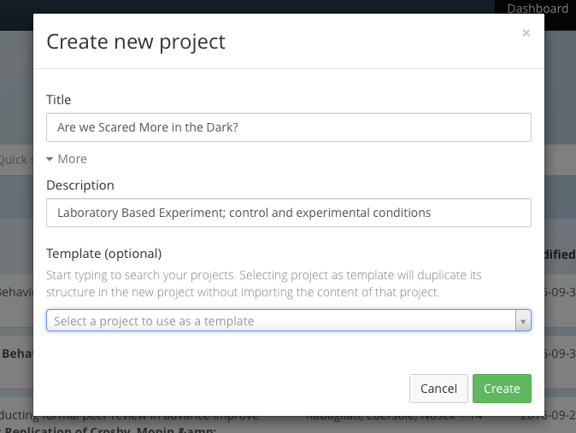
New Project: Are we Scared More in the Dark?

Slide 16
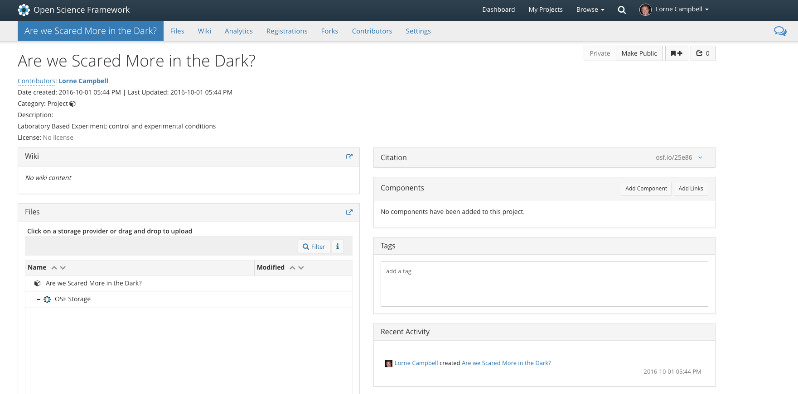

Slide 18
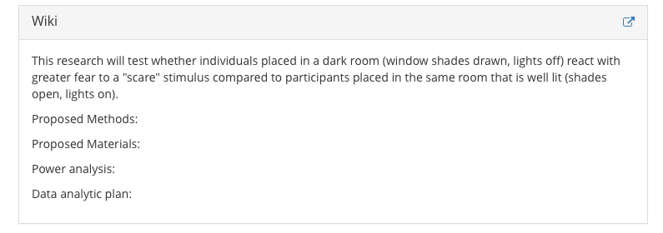
Example: Using the Wiki

Slide 19
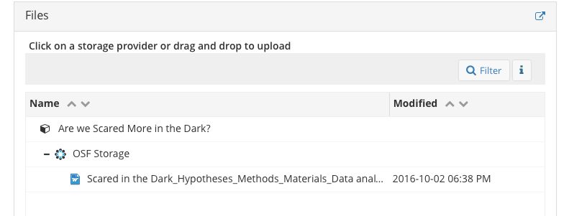
Example: Using the “Storage”

Slide 20
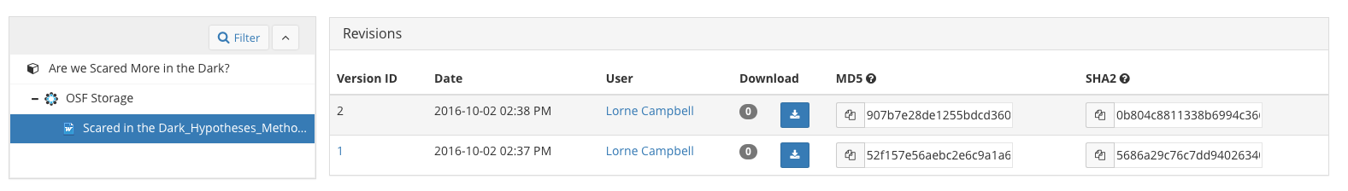
Example of Version Control

Slide 21
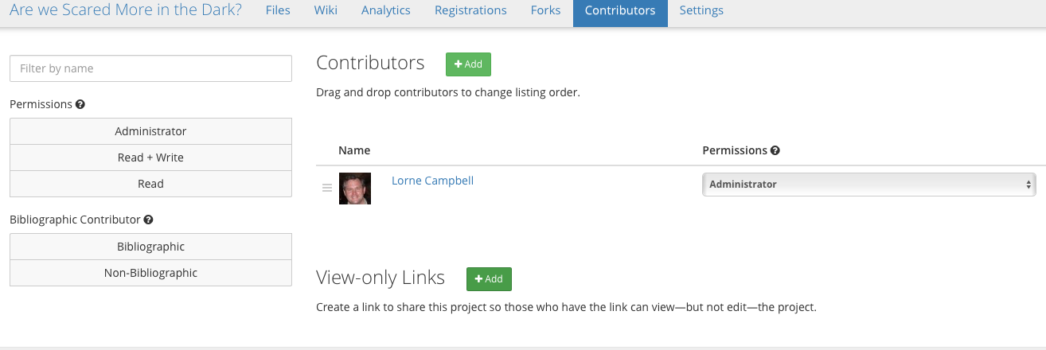
Different Types of “Contributors”
Add colleagues for different projects
Use “view only” links, including sharing
anonymous links for reviewers

Slide 22
Example: How My Lab Uses the OSF to Organize our Open Science

Slide 23
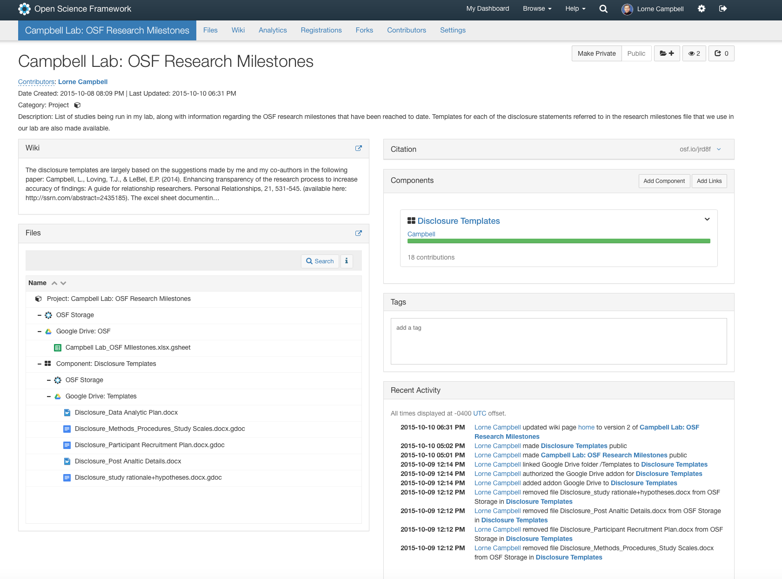

Slide 24
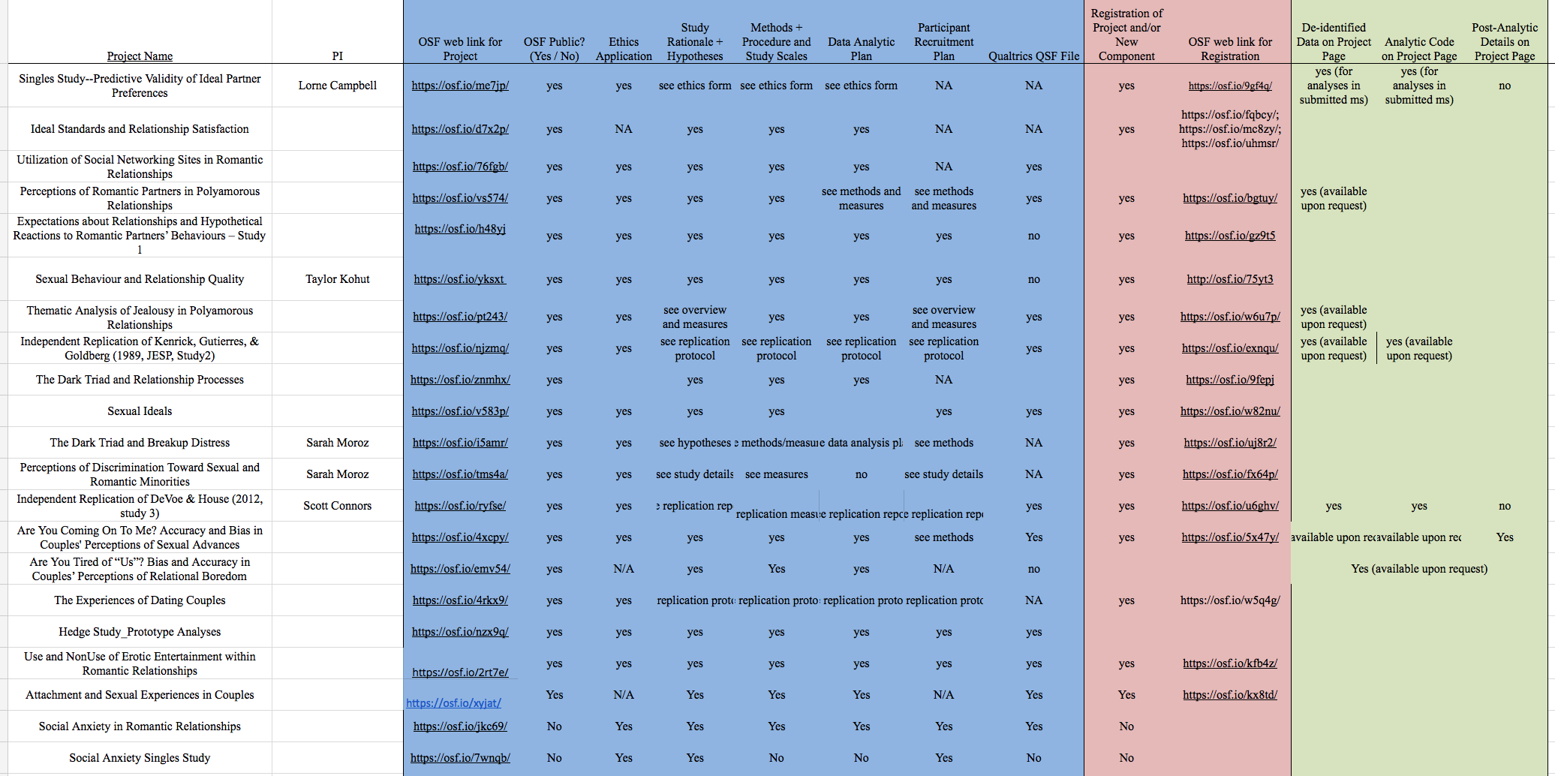

Slide 25
Disclosure Statements
Study Rationale & Hypotheses
Methods, Procedures and Study Scales
Data Analytic Plan
Participant Recruitment Plan (if applicable)
Post-Analytic Discussion

Slide 26
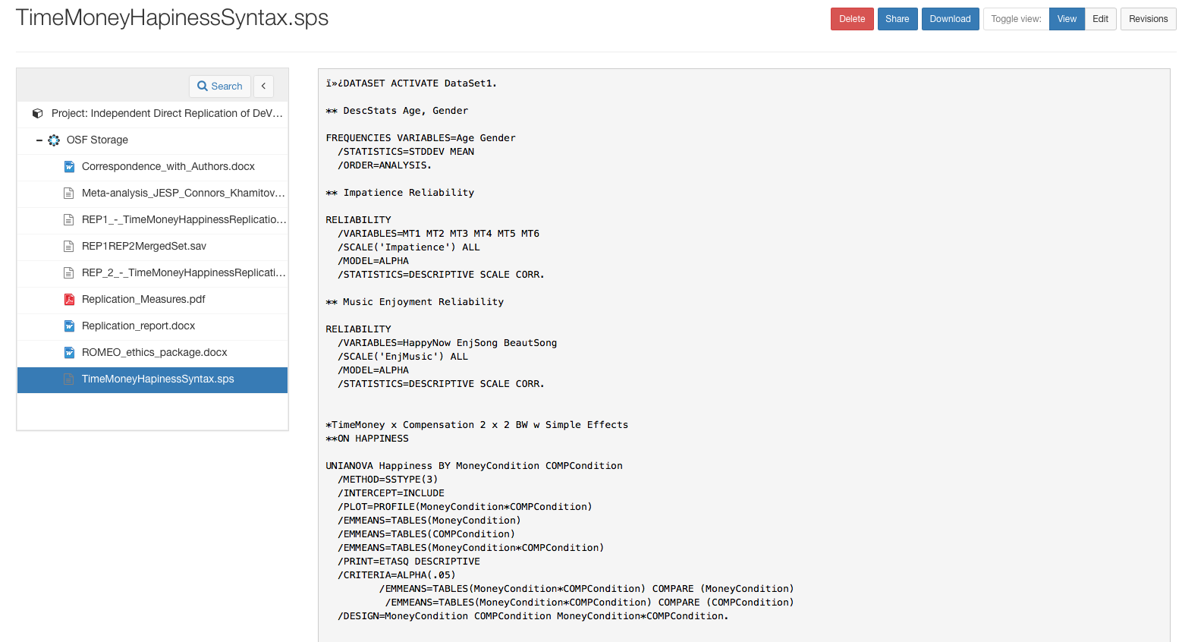
Sharing Analytic Code

Slide 27
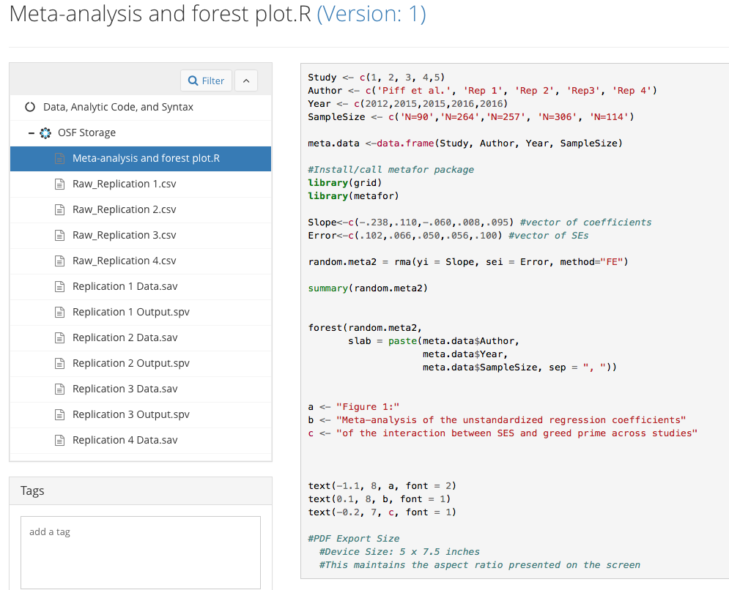
Sharing Analytic Code

Slide 28
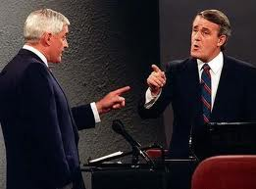
“You Had an Option, Sir”
We all have the option to adopt open, or closed, research
practices; it is our choice. When deciding what option to choose, ask
yourself if that is the best choice for advancing scientific discovery.
We have the obligation of sharing our choice for open or closed
research practices.

Slide 29
